Slide 1
Routing with Vyatta + VM Networks
By The Handsome Seastars

Slide 2
Packet Tracer Emulation
The Handsome Seastars

Slide 3
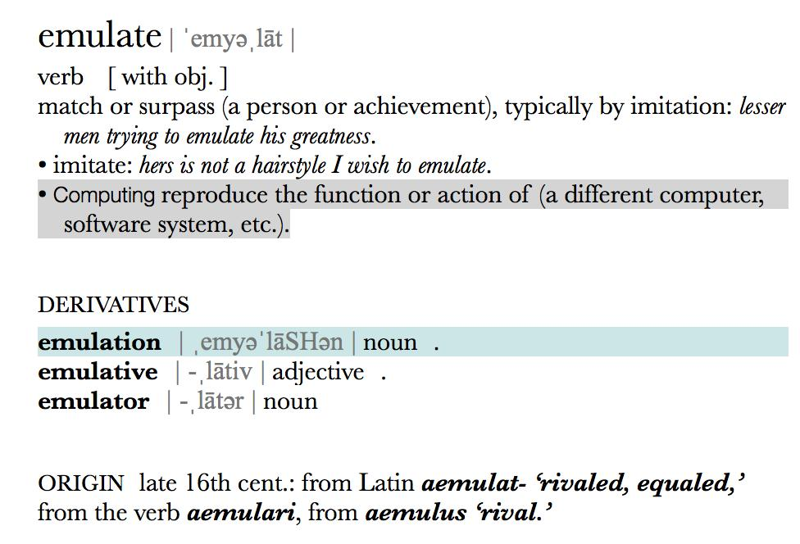
What is emulation?

Slide 4
Emulation versus Virtualization
Virtualization is creating a virtual version of something.
Emulation is reproducing the function or action of something else.
For example, your computer does not merely reproduce the function of pfSense when running it in a VM -- it creates a virtual version of it and RUNS Ubuntu in full.
However, if I build a system that somehow allows you to practice, say, setting up rules in pfSense but NOT actually enforcing them -- that is emulation.

Slide 5
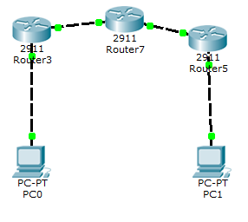
Setting up Emulation
We set up end devices and routers to represent all Windows, Ubuntu, both Vyatta VMs, and the pfSense VM.
The middle machine is our
gateway, and thus
represents pfSense.
Subnet 2
Subnet 1
Subnet 3

Slide 6
Difference between Virtual Adapter Modes
NAT or Shared: routes the guest’s traffic through the host’s connection using NAT locally. Both the guest and host share a single IP.
Bridged: gives the guest direct control of the host’s router. Can be problematic, as the guest can “kick off” the host from the interface and knock the host offline.
Host-only: the guest is confined to a network limited to the machine only. VM’s can talk to each other across this network.

Slide 7
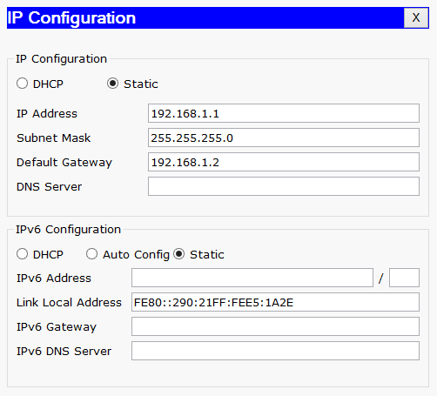
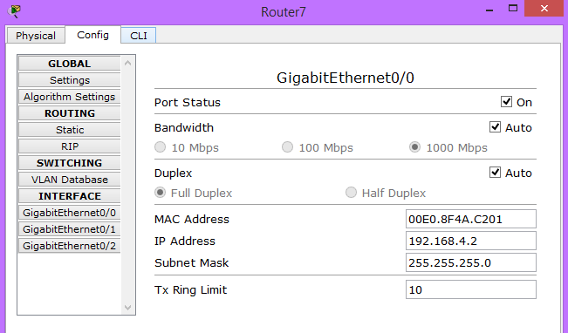
IP Configurations
We setup the IP’s for the end devices and routers in between just like the IP’s on our VM’s

Slide 8
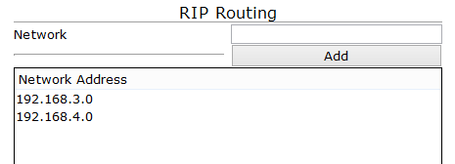
RIP Routing
We then setup RIP routing on all the routers

Slide 9
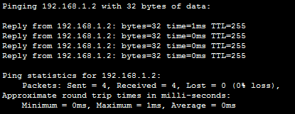
Testing Emulation
We were then able to ping across the entire network through all 3 routers.

Slide 10
Deviation from Emulation
The differences between the emulation and practiced versions of the network were that the devices all had OS’s on them.
Windows had it’s own way of assigning static IP’s
Vyatta had difficulty with default static routing and needed RIP to get passed it’s own router.
pfSense required another package we couldn’t download to even attempt RIP. As well as added packet security that would have been difficult to configure to ping around
In theory, we can easily create this network.
In practice, the OS’s and actual security and networking of the individual OS’s make it difficult.

Slide 11
Windows 7
The Handsome Seastars

Slide 12
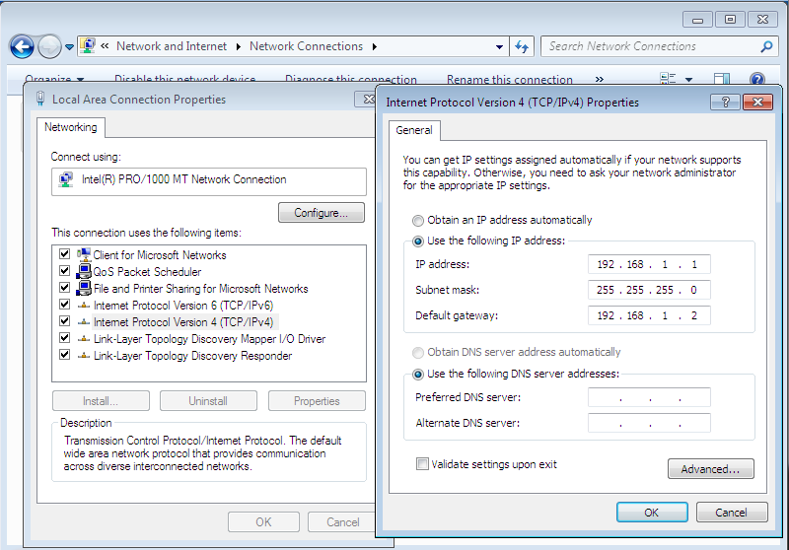
Setting Static IP in Windows
Under Control Panel -> Network and Internet -> Network Connections you can Right Click -> Properties on the network connected to the Vyatta router then double click IPv4 and Check “Use the following IP address” and enter the stat IP

Slide 13
Linux
The Handsome Seastars

Slide 14
Setting the Static IP for Ubuntu
sudo nano /etc/network/interfaces
auto lo eth0 iface lo inet loopback iface eth0 inet static address 192.168.2.1 netmask 255.255.255.0 gateway 192.168.2.2 (router’s address)
Control X , y

Slide 15
Vyatta
The Handsome Seastars

Slide 16
Vyatta
Available since March 2006
Subsidiary of Brocade Communications Systems
Totally virtualized competitor to Cisco and Juniper
Replaces IOS 1800 through ASR 1000 routers as well as ASA 5500 security appliances
Supports Xen, VMware, KVM, Rackspace, and Amazon EC2/AW2 services

Slide 17
Vyatta: More on Supported Platforms
As we said before, systems supporting Vyatta include Xen, VMware, KVM, Rackspace, and Amazon EC2 and AWS services.
Xen is an open-source hypervisor created at Cambridge. It is similar to VMware’s ESX and ESXi products -- but free :)
KVM runs a bare-bones Linux kernel as a hypervisor. It is also open-source and free!
Rackspace provides virtual infrastructure through the cloud -- similar to Amazon’s elastic compute 2 or EC2 service. The advantage to using these is that they allow you to add as much hardware as you want on the fly -- no more overpaying for hot, costly, noisy server rooms!
AWS is Amazon Web Services. It’s like Elastic Compute, but for Web applications which you can also run in the cloud.

Slide 18
Use Cases for Vyatta
If your network, on the whole, deals with packets < 512B in size.
If your network handles less than 10Gbps traffic.
If in a home, office, small, or medium-sized business.
If there’s a need to cut costs.
If network load tends to vary often -- to the point where buying huge network equipment could be considered overkill.
If there’s a need to save space and/or power.
If you don’t particularly value 24/7 uptime or superb redundancy.
If you favor customizability and openness. (VyOS)
If you’d like a machine that can serve more than one purpose, be that in networking, or as a general server.
If you’re the average consumer who doesn’t have access to the market for Cisco or Juniper network-grade equipment, but still would like advanced networking, firewalling, and traffic management capabilities.

Slide 19
Vyatta structure
Specialized: Debian-based + networking applications
Quagga open-source software suite -- supports number of gateway protocols
Open Shortest Path First: network topology mapper for the Internet layer
RIP
Border Gateway Protocol: routes externally based on distance-vector routing (where routers inform their immediate neighbors of topology changes), or policies configured by a network admin
Intermediate System - Intermediate System (ISIS): routes internally
Management console like IOS and JUNOS + GUI
OpenVPN

Slide 20
Vyatta, closed-source edition
Closed-source virtualized router for subscription-based purchase from Brocade
Subscription-based purchase model
Additional capabilities over Vyatta Core (deprecated open-source version)
Access to Brocade’s RESTful APIs for web applications (so remote web management and provisioning works)
Serial connection support
TACACS+ (Terminal Access Controller Access Control System) authentication, authorization, accounting services
Originally created for DARPA in 1984
Open standard since 1993
Alternative to RADIUS
No transmission control necessary
Encrypts all authentication-related information → more secure than RADIUS
Configuration sync
System image cloning
24/7 software updates, support, and training

Slide 21
Vyatta Core: open-source edition
Free
CLI only
Supports advanced IPv4/6 routing, stateful firewalling, IPsec and OpenVPN
Development halted
Last released May 2013
Forked independently to VyOS

Slide 22
VyOS: active, free alternative
Completely free, open-source routing platform
Competes with commercially available solution
OVA image pre-made for VMware; includes tools
Majority of the features of commercial Vyatta
Scriptable, unified, hardware-esque command-line
Stateful configuration system
Options to commit/discard changes, rollback changes or to previous revisions, archive…
Image-based backups
Complex routing protocols
Serial console
VLAN, VPN + IPsec, DHCP/caching DNS/proxy/Telnet/SSH, IPv6 services
Port-mirroring, redirection
Dummy interfaces and pseudo-internet
Wireless access-point functionality
Task scheduling, SNMP, remote access + logging
Physical or virtualized

Slide 23
Physical vs Virtual: Pros of Virtual
Virtual can mean significant savings + benefits in SOME cases
24-port switch: ~$20k physical, ~$9k virtual
Destroys Cisco/Juniper in price-to-performance
Runs circles around outdated, pricey big iron, or even existing setups, especially with large-packet (>512 bytes) traffic
Even just a quad-core Intel CPU is sufficient for many uses
Max of 3 million packets per sec. is impressive
Hardware swappable
Need space for more routing tables? Just add more RAM
For smaller networks, virtual’s the way to go

Slide 24
Physical vs Virtual: Pros of Physical
But virtual is not always better
x86 is unspecialized -- not specifically made for transporting network traffic
ASICs (application-specific integrated circuit) of Cisco and Juniper products are specialized by nature
Minimal overhead allows for more complicated setups
More routing tables...
More firewall rules…
...more of everything
Faster under heavy load
Less risk of failure + downtime(though can be mitigated)
Virtual setups are trivial to DDoS as well
You probably won’t be running 10Gpbs of small-packet on a VM

Slide 25
Vyatta, as it relates to this lab
This lab presents an optimal use case for Vyatta.
Our network doesn’t necessitate multi-gigabit traffic.
Overhead from the host OS doesn’t make that much of a difference.
Being a virtual machine, Vyatta was configured with just a click. We could enable, disable, and install services on a whim.
We only require simple services such as RIP --
-- though for anything more complicated, Vyatta could certainly get the job done.

Slide 26
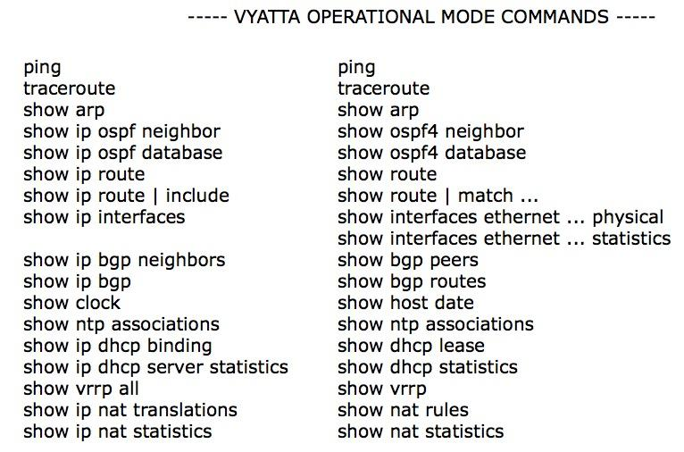
Command Comparison: Operational
Cisco
Vyatta

Slide 27
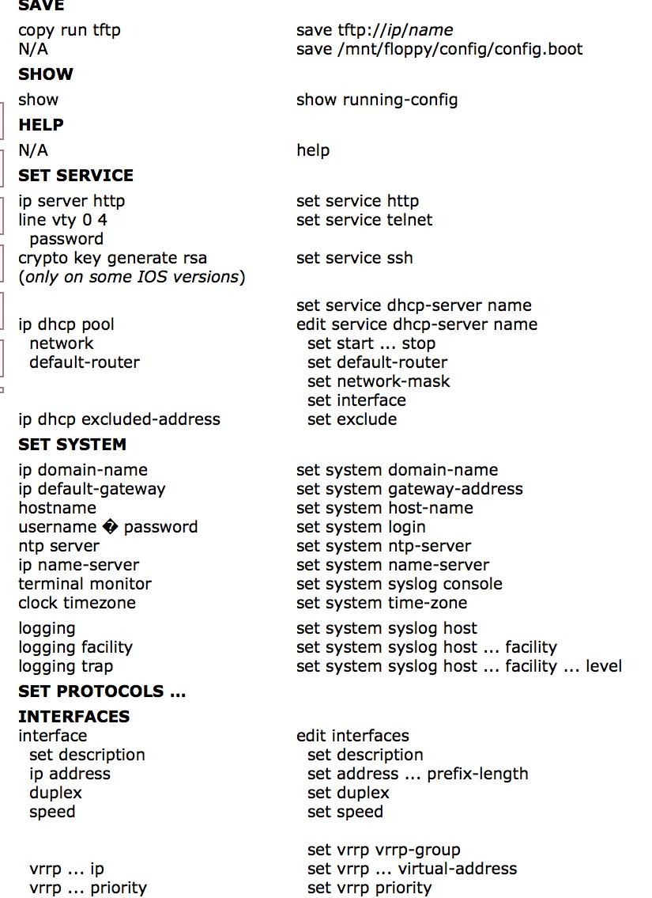
Command Comparison: Configurational 1
Cisco on the left
Vyatta on the right

Slide 28
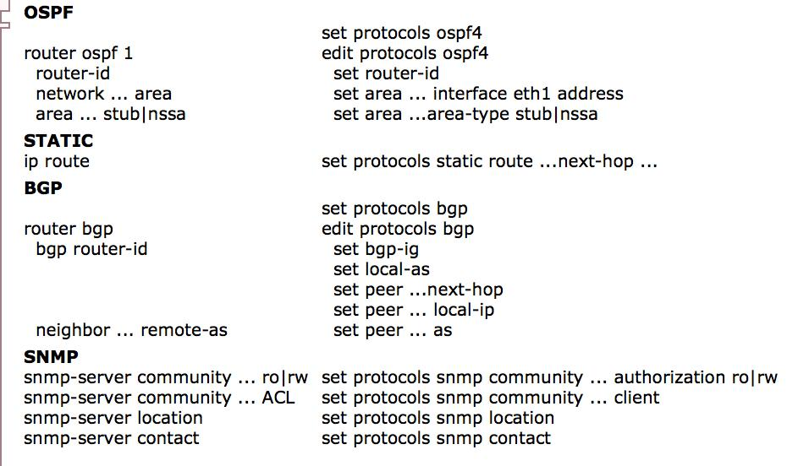
Command Comparison: Configurational 1
Cisco on the left
Vyatta on the right

Slide 29
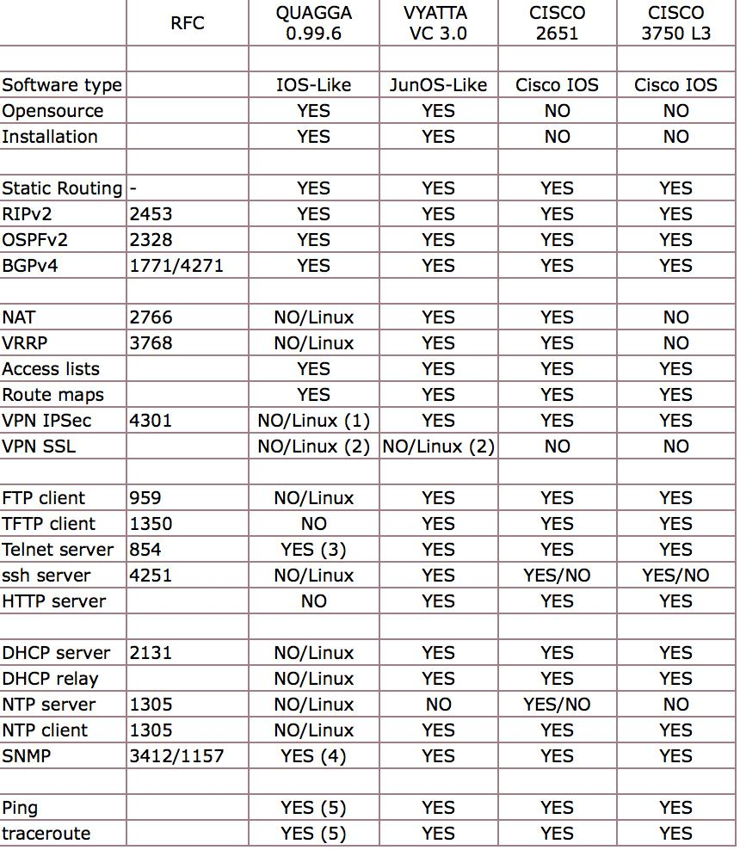
Quagga vs. Vyatta vs. Cisco
Here’s a comparison between two of the best open-source software suites available, Quagga and VyOS, vs. a standard Cisco 2651 router and a Cisco layer-3 switch.

Slide 30
Quagga vs. Vyatta: two options for the cost-conscious
Vyatta is its own, fully-fledged Debian derivative. Both Vyatta and VyOS incorporate Quagga
Quagga is a set of open-source tools, including a routing daemon (zebrad), that was a fork of the defunct GNU Zebra project, that can be put on any Linux-based system.
Use cases: if you already have a Linux install that works for you; easy setup for home use.
Fun fact: quagga = extinct zebra.
Downloadable from http://www.nongnu.org/quagga/

Slide 31
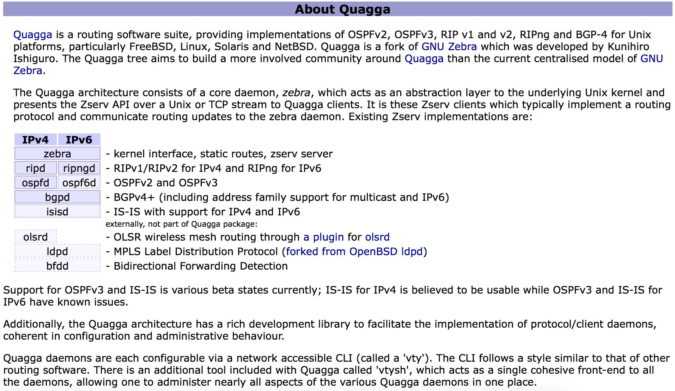

Slide 32
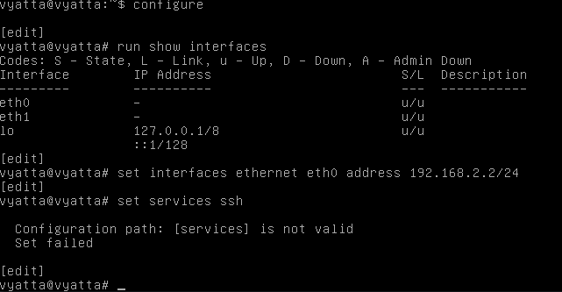
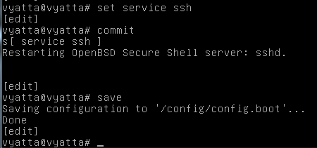
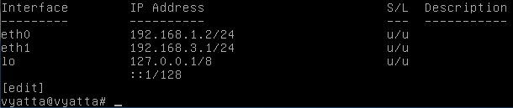
Static IP on Vyatta
system install >> fixes commit errors
configure
set interfaces ethernet eth0(or eth1) xxx.xxx.xxx
set service ssh
commit
save
(Optional)
run show interfaces (displays network adapters)

Slide 33

RIP on Vyatta
Configure
Set protocols rip network xxx.xxx.xxx/24
Commit
Save
(Oprional)
run show configuration (displays network adapters)

Slide 34
pfSense
The Handsome Seastars

Slide 35
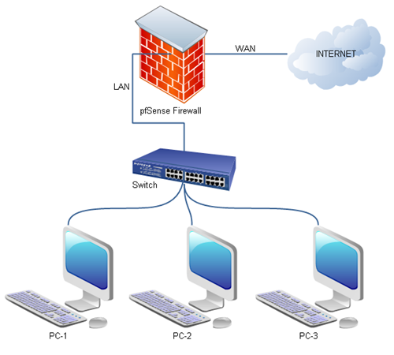
Overview of the pfSense network
pfSense serves as a combined gateway (interfacing between local and wide-area networks) and proxy (relaying and filtering our hosts’ network requests) between the “wild, wild west” of the Internet and our hosts.
That’s why we input its IP as the “Default Gateway” for all our computers.

Slide 36
Installing the Routing Information Protocol on PFSense
Under System -> Package Manager, we can install the RIP package for pfSense.

Slide 37
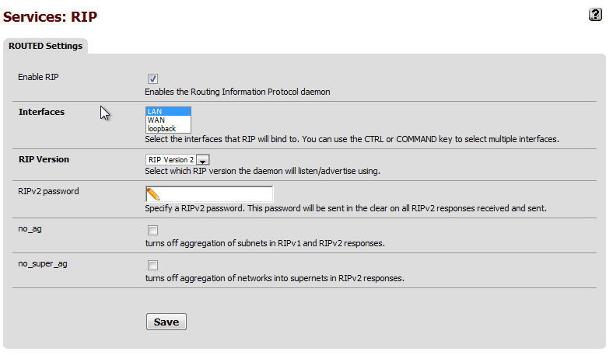
Configuring RIP
Under Services -> RIP, we can setup RIP routing for pfSense.
RIP auto-detects IP’s and automatically configures routing schemes accordingly.

Slide 38
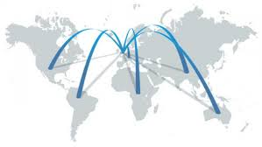

WAN, LAN and Loopback
WAN - Wide Area Network
connection of long distances
most common are telephone lines,radio waves, and fiber optic cable
LAN - Local Area Network
networks of computers in close proximity
most common are ethernet and Wi-Fi
Loopback
Allows applications on the same machine to use the IP stack (the network) to communicate with each other.
The loopback address is also known as 127.0.0.1, or the hostname “localhost”.
Also provides testing ability through the Windows Loopback Adapter or the lo0 adapter on Unix.

Slide 39
Sources
https://www.howtoforge.com/linux-basics-set-a-static-ip-on-ubuntu
http://www.linuxcat.org/showthread.php?tid=66
http://www.networkworld.com/article/2285043/lan-wan/vyatta-open-source-router-aims-at-cisco.html
http://www.webhostingtalk.com/showthread.php?t=1235437
http://www.openmaniak.com/vyatta_compare.php
http://www.cisco.com/c/en/us/td/docs/ios-xml/ios/mcl/allreleasemcl/all-book/all-13.html
http://www.openmaniak.com/quagga_func.php
http://www.nongnu.org/quagga/

